Slide 1
Agile Arbeitsweisen
SCRUM, Kanban & SAFe

Slide 2
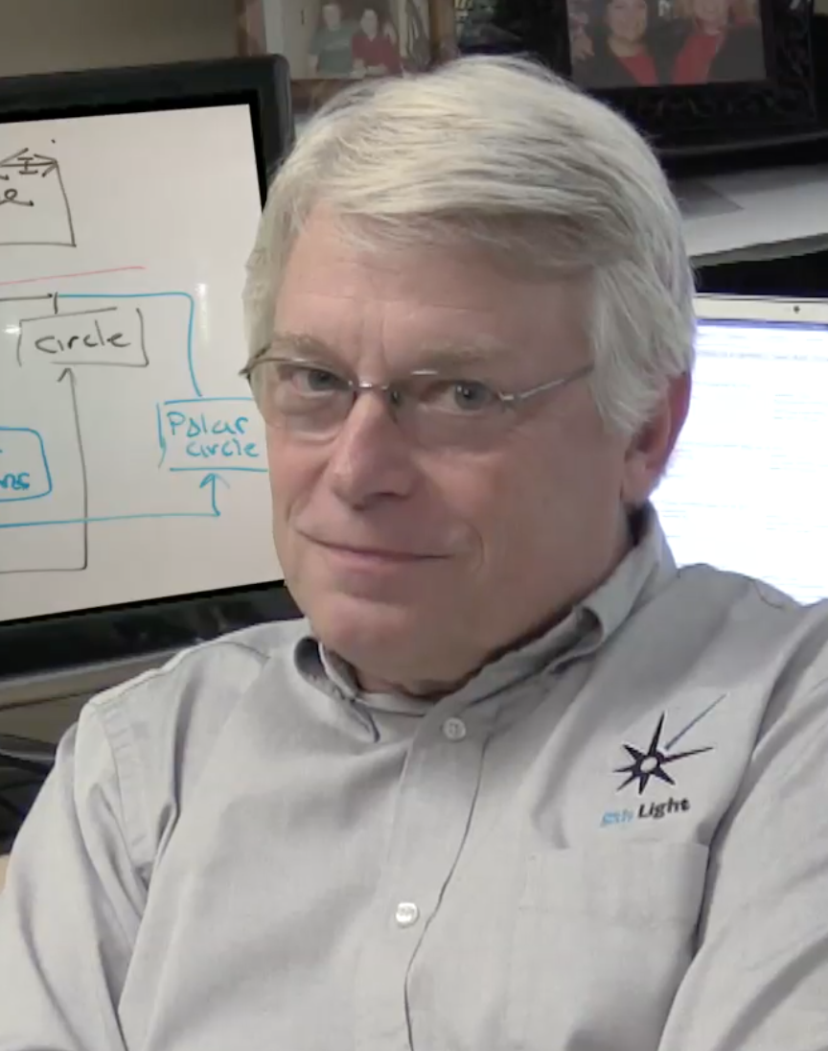
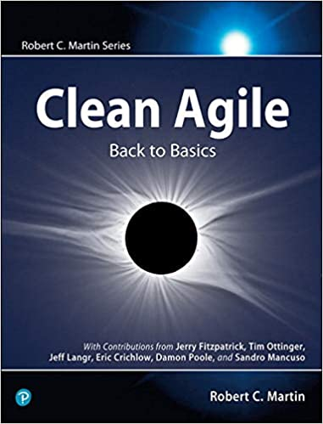
Agile Kernpunkte
Small Problems
Small Teams
Small Things
(2021 Robert C. Martin – Clean Agile)

Slide 3
Agile Manifesto
2001, Treffen von 17 Entwicklern u.a. Robert C Martin, Kent Beck, Ward Cunningham, Jeff Sutherland, Martin Fowler, …
Individuals and interactions over processes and tools
Working software over comprehensive documentation
Customer collaboration over contract negotiation
Responding to change over following a plan

Slide 4
Agile Principles
Customer satisfaction by early and continuous delivery of valuable software.
Welcome changing requirements, even in late development.
Deliver working software frequently (weeks rather than months)
Close, daily cooperation between business people and developers
Projects are built around motivated individuals, who should be trusted
Face-to-face conversation is the best form of communication (co-location)
Working software is the primary measure of progress
Sustainable development, able to maintain a constant pace
Continuous attention to technical excellence and good design
Simplicity—the art of maximizing the amount of work not done—is essential
Best architectures, requirements, and designs emerge from self-organizing teams
Regularly, the team reflects on how to become more effective, and adjusts accordingly

Slide 5
Agile Methoden
Extreme Programming
Kanban
SCRUM
SAFe
…

Slide 6
Kanban
Backlog | To Do | In Work | Done

Slide 7
SCRUM Pillars
Transparency
Inspection
Adaptation

Slide 8
SCRUM Values
Commitment
Openness
Courage
Respect
Focus

Slide 9
Scrum Artifacts
Ggf. einfache Mittel statt High Tech
Einfach zu bedienen.
Wichtige Bestandteile: Product / Sprint Backlog und die Tasks!

Slide 10
Scrum Rollen
Product Owner
SCRUM Master
Team

Slide 11
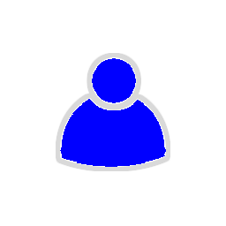
Product Owner

Slide 12

Scrum Master

Slide 13

Team

Slide 14
1. Sprint Planing Meeting

Slide 15
2. Task Breakout

Slide 16
3. Sprint mit Daily Scrum

Slide 17
4. Sprint Review

Slide 18
5. Sprint Retrospective

Slide 19
Scrum Artifacts
Product
Sprint Backlog / Tasks
Ggf. einfache Mittel statt High Tech
Einfach zu bedienen!

